Slide 1
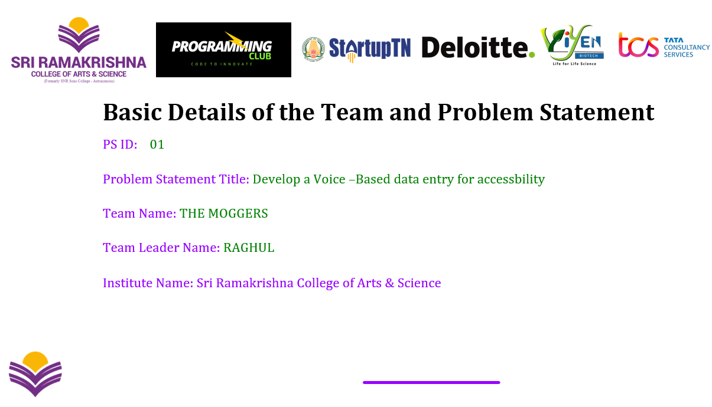

Slide 2

Idea/approach Details
Custom Commands: This innovative feature enables users to personalize their experience by crafting and assigning unique voice prompts to perform designated actions seamlessly. In essence, it empowers individuals to tailor their interaction with a system or device according to their preferences and needs. By creating custom commands, users can streamline their workflow, enhance efficiency, and improve productivity by executing specific tasks quickly and effortlessly. Moreover, this customization option fosters a more intuitive and user-friendly interface, allowing for a more personalized and engaging user experience. Overall, the ability to define and utilize custom voice commands opens up a world of possibilities for users seeking to optimize their interactions with technology and create a more tailored and efficient workflow.

Slide 3
Implementation Steps:
Step 1: User interface for command creation Design: A form in which users can specify an action by entering a command phrase .
Application: Use web frameworks (e.g., React, Angular) to create form and backend applications to handle data storage.
Step 2: Voice command recognition Design: Integrate language and text APIs.
Usage: Use JavaScript to take the voice input and send it to the API for writing.
Step 3: Indicative Analysis and Recommendations Design: Develop a context recognition algorithm using usage data.
Exercise: Use machine learning models to predict and propose context-based policies.

Slide 4
Step 4: Order Execution
Design: Create event handlers for each set of commands.
Function: Create server-side scripts to execute commands and send the results back to the user interface.
Step 5: Integration with external systems
Design: Describe the API and data exchange format.
Functionality: Use RESTful APIs to integrate with external applications such as CRM or business management tools.

Slide 5
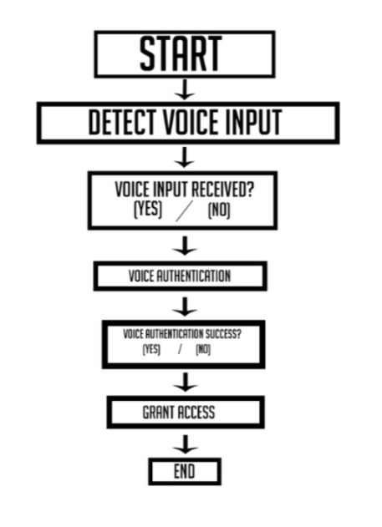

Slide 6
Benefits
The voice data entry system offers many advantages, especially for users with limited typing or visual impairment. Here are some of the main benefits
1.Accuracy and error reduction Voice Command Accuracy: Reduces the chances of typing errors and improves the accuracy of data entry when the voice recognition system is optimized Real-time correction: Provides immediate feedback and correction mechanisms, allowing users to correct errors as they occur.
2. Integration and automation Seamless integration: Allows you to integrate with other applications and systems to automate common tasks and simplify operations.

Slide 7
Automated processes: Supports automation of complex sequence tasks, for efficiency and consistency.
3. Improved communication
Effective Communication: Provides quick and easy communication, such as emails or text messages, which can be more efficient than typing.
Language Support: Provides multilingual support, allowing users to interact with the technology in the language of their choice.
4. Save time
Faster input: Reduces the time required for data entry tasks by using faster input language compared to type.
Streamlined workflow: Simplifies complex planning and workflows, saving time and effort.

Slide 8
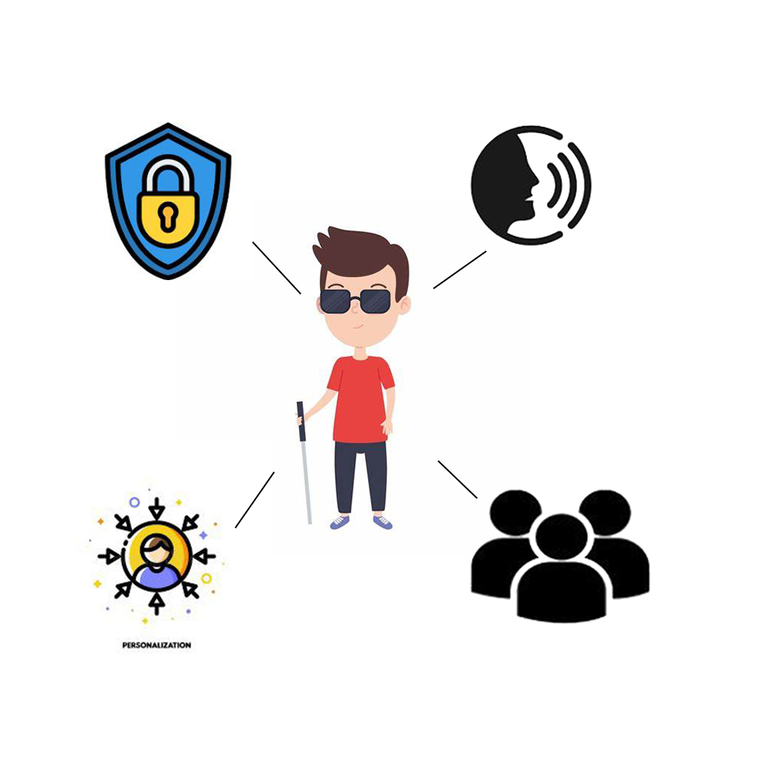

Slide 9
Use Cases:
Healthcare :
Patient Management: Custom commands like “Update patient history” or “Add new allergy” allow healthcare professionals to quickly input and manage patient data.
Treatment Protocols: Commands such as “Generate treatment plan for [condition]” streamline the creation of standardized treatment documents.
2. Legal
Document Drafting: Commands like “Insert legal disclaimer” or “Prepare contract template” facilitate the rapid drafting of legal documents.

Slide 10
Case Management: Custom commands such as “Retrieve case file for [case number]” help lawyers quickly access relevant case details.
3. Customer Service
Ticketing System: Commands like “Create new support ticket” or “Update ticket status to resolved” streamline the ticket management process.
Information Retrieval: Custom commands such as “Retrieve customer purchase history” provide quick access to relevant customer information.

Slide 11
THANK YOU

